Slide 1
Nitrogen Network Plot Data

Slide 2
20 Plots
1 Pre Plant Vs. Side dress
1 Anhydrous Vs. 28%
2 N Serve Studies
2 Boron in 28% Side dress
2 RX Vs. Flat Rate
4 OptRx Studies
9 Rate Studies
Also 2011 vs. 2012 Yield to Fertility Levels

Slide 3
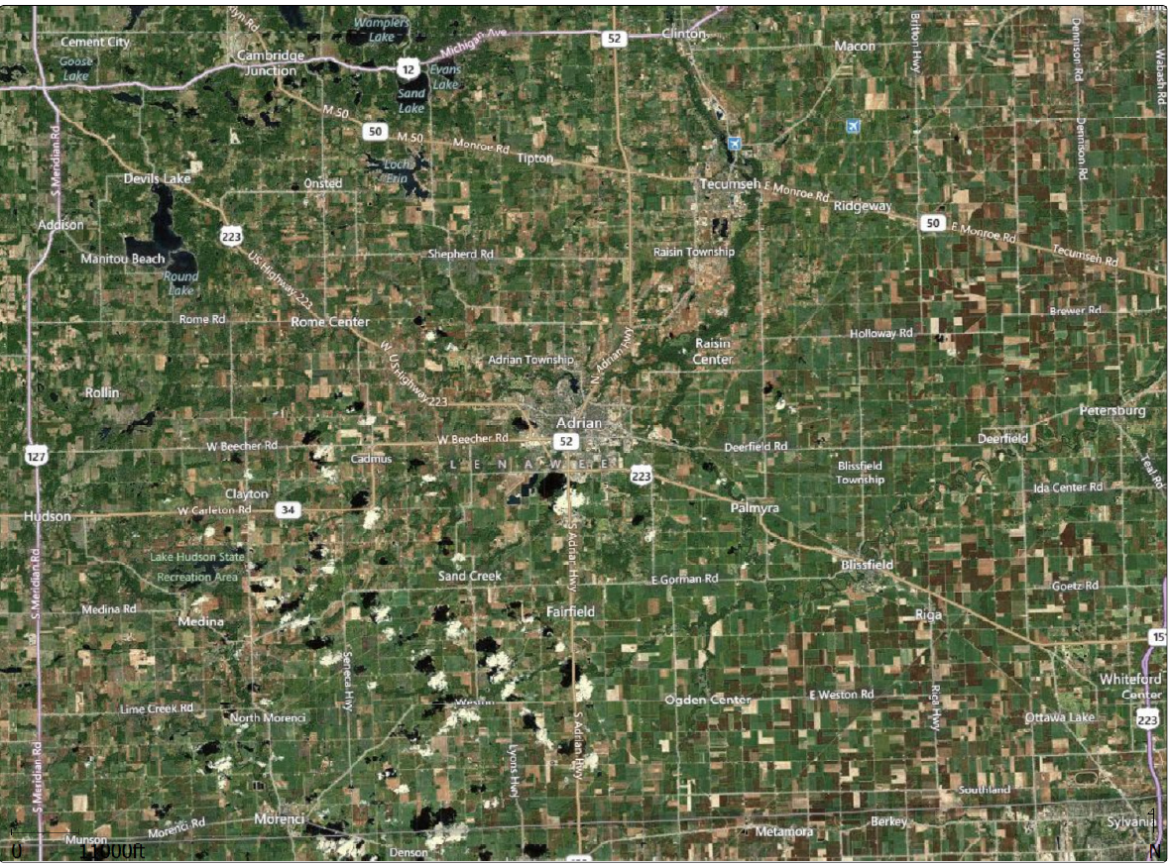

Slide 6
My Personal Predictions for Plots Before Harvest
Preplant would out perform Sidedress
nH3 would out perform 28%.
N Serve would make no difference.
Boron would make no difference.
No Idea what to expect on N RX.
OptRx would not works as well.
Higher Rates of N would produce more corn.

Slide 7
How the Plot Data Will Be Presented
Summary of Plot Will Be Shown First.
Followed by a chart showing deeper analysis.
Layout of Plots
Consistency of Performance

Slide 8
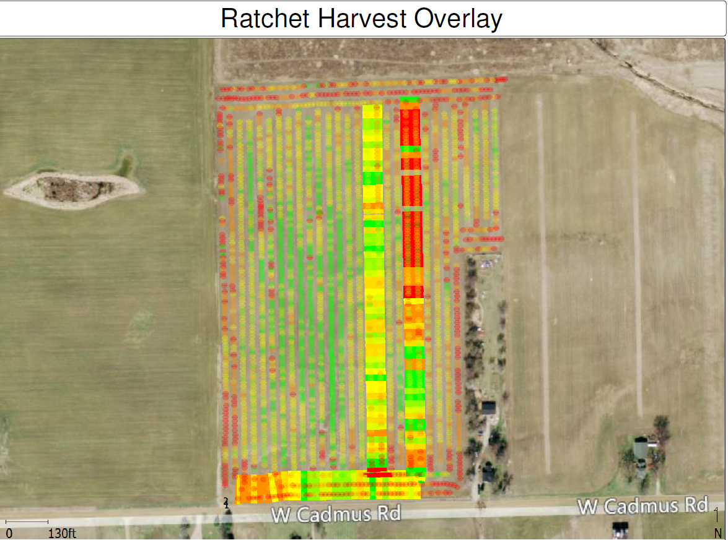
Data Extraction

Slide 9
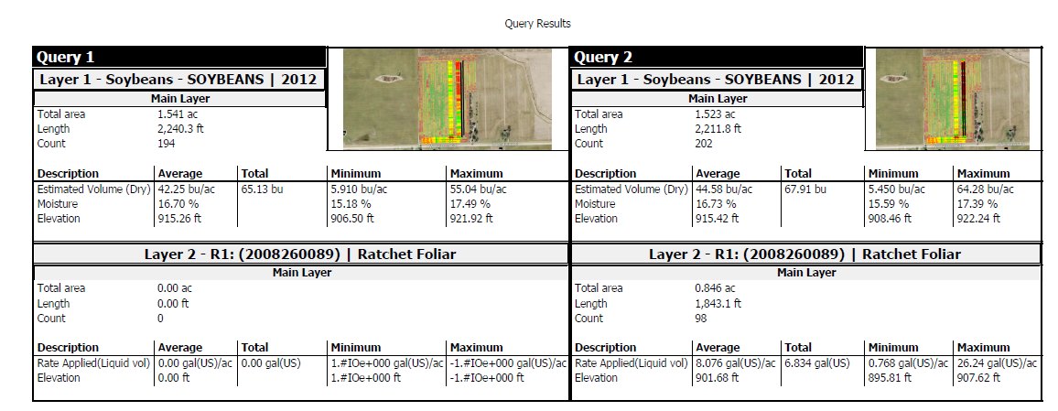
Query Results

Slide 10
NH3 vs. 28%

Slide 11
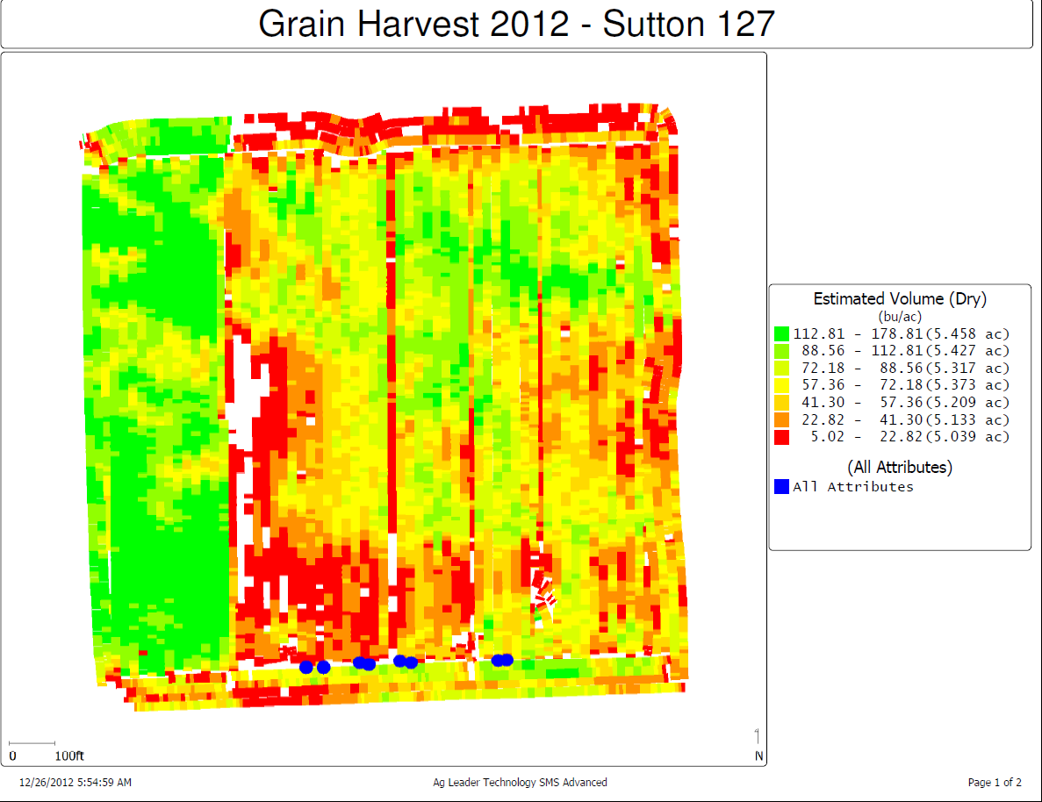

Slide 13
Pre Plant Vs. Side Dress

Slide 26
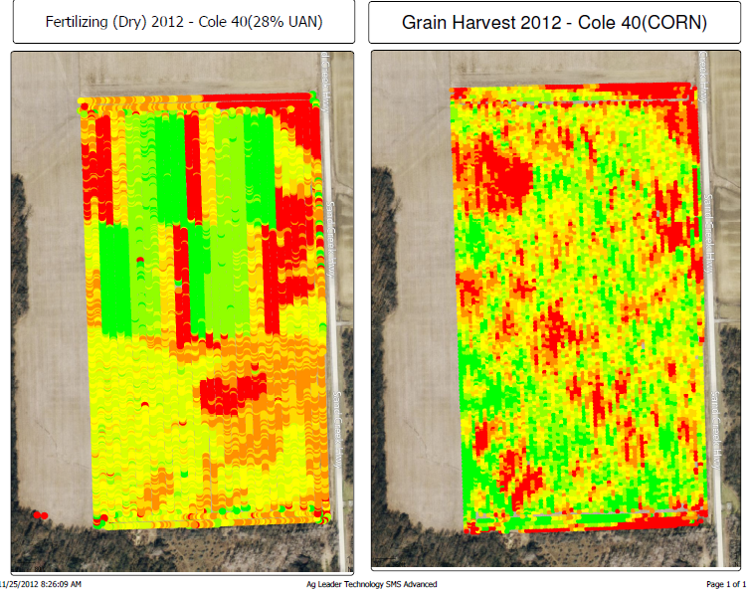
Rick Ries Block Type Testing

