Slide 3
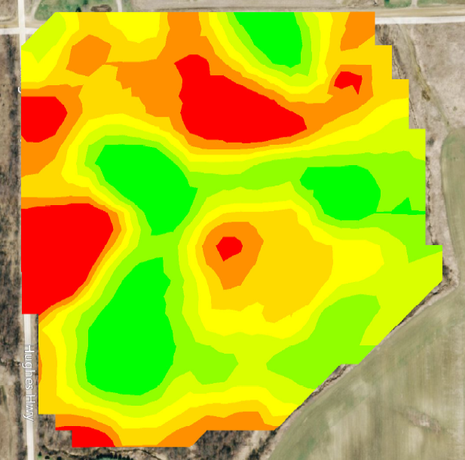
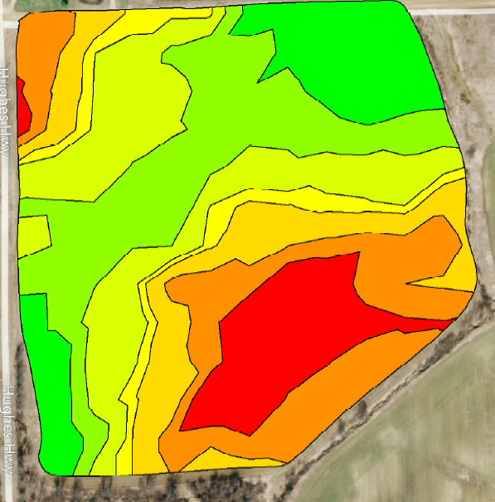
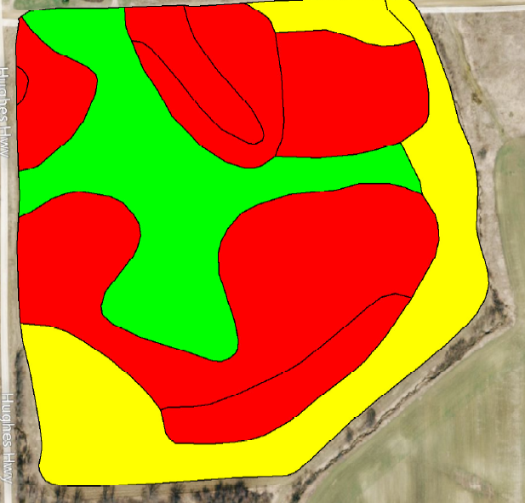
VRT Nitrogen
Appling more N in high productive areas. And less N in less productive areas. These are often built on one of these 3 models.
YIELD MAP
CEC MAP
SOIL SURVEY MAP

Slide 4
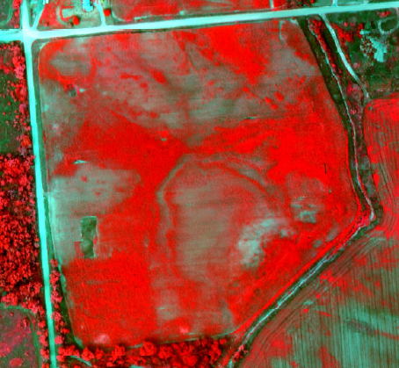
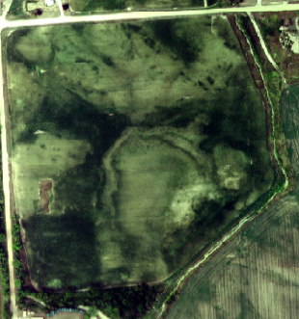
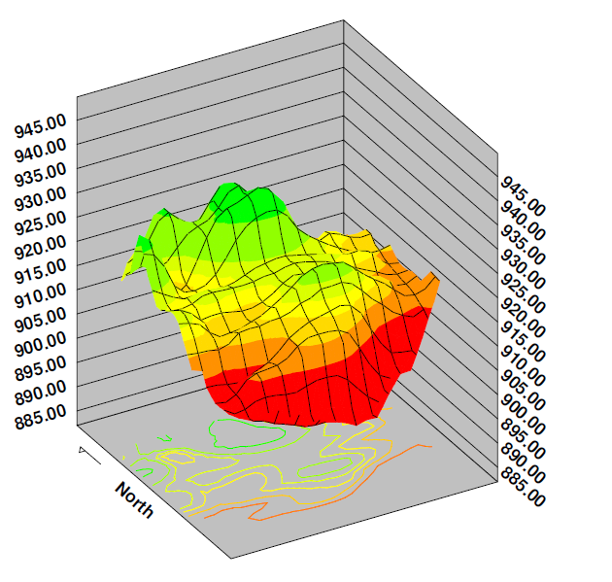
INFRARED PHOTO
COLOR PHOTO
YIELD MAP
3D ELEVATION MAP

Slide 5
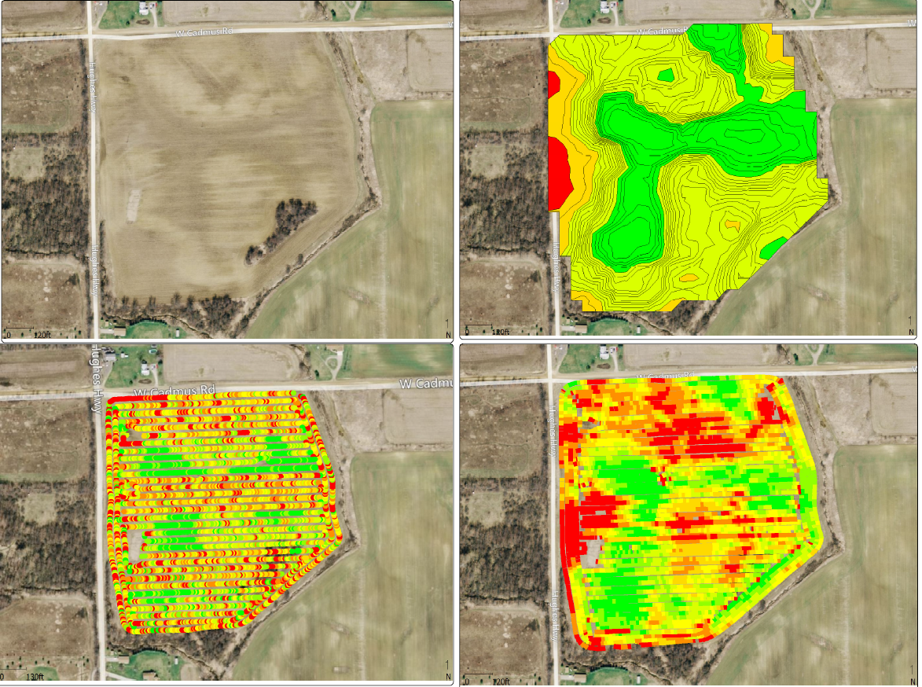
RX MAP
SATILLITE PHOTO
AS APPLIED MAP
YIELD MAP

Slide 9
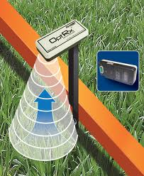
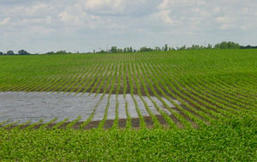
2nd Generation for VRT Nitrogen
Use the technology to judge crop health and apply to crop needs at the time of application.

Slide 10
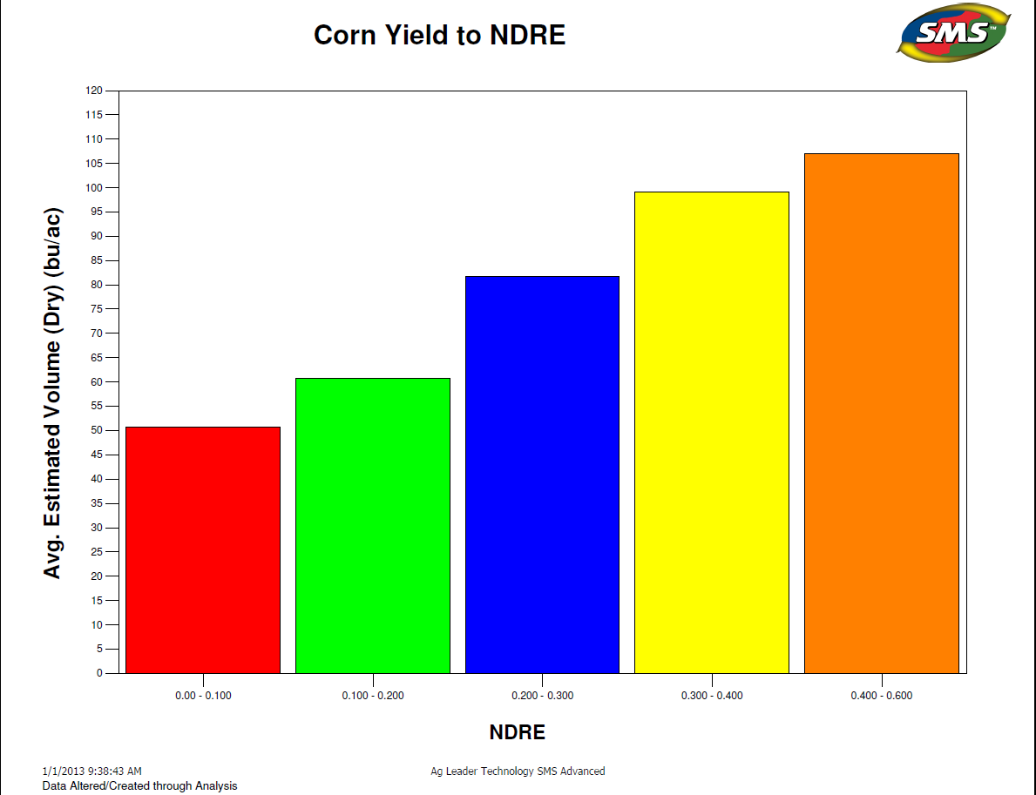
(NEAR INFRARED)
200 ACRES

Slide 11
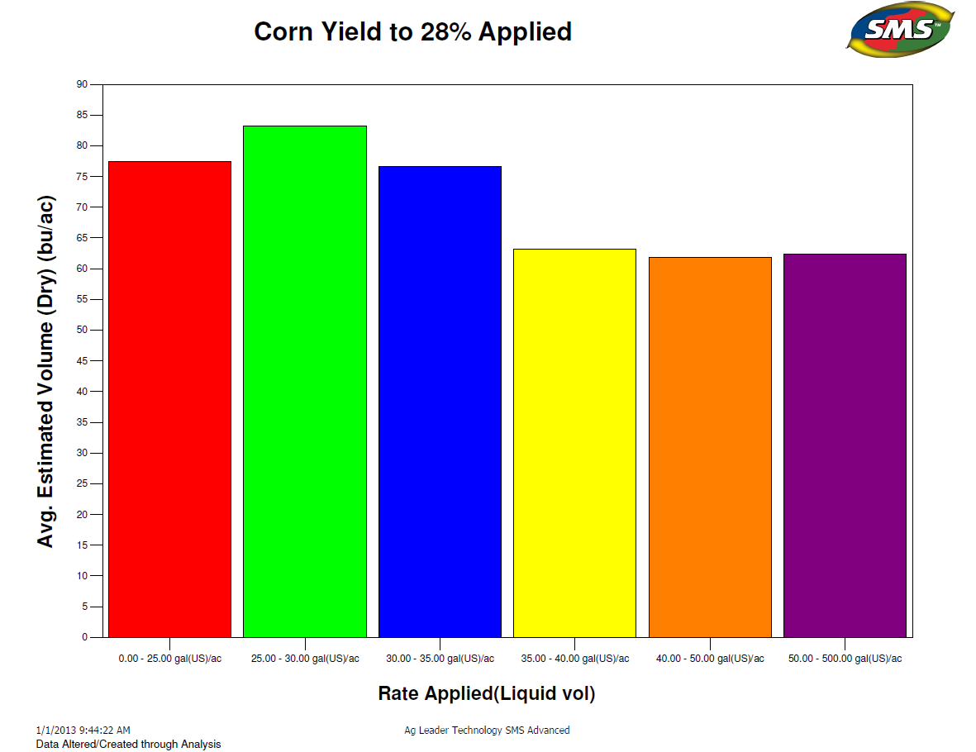
(NEAR INFRARED)
200 ACRES

Slide 12
Optrix perscribed 35 more lbs. of N and produced 40 more bushels!

Slide 17
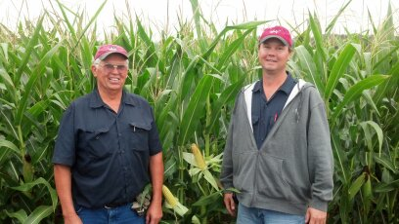
VRT to Plant Health
Larry Ries, “I saved 6.8 Gallons per acre over Flat Rate using the OPTRIX Crop Sensors.”
6.8 Gallons
X 10.6 # per gal.
72.08#
X28%
20.18# per acre
X .60 Per # N
$12.10 per acre or
$12100 for all his Corn Acres
Larry and John Ries
Tipton Michigan

Slide 23
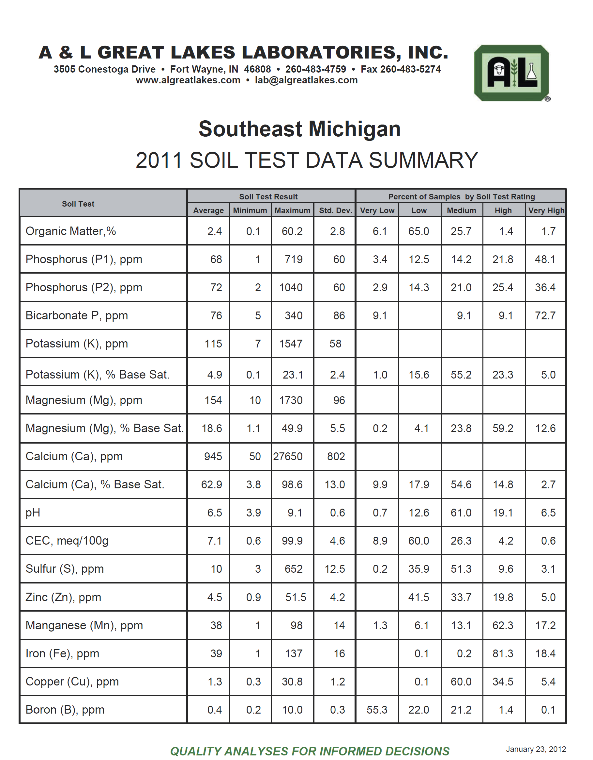

Slide 24
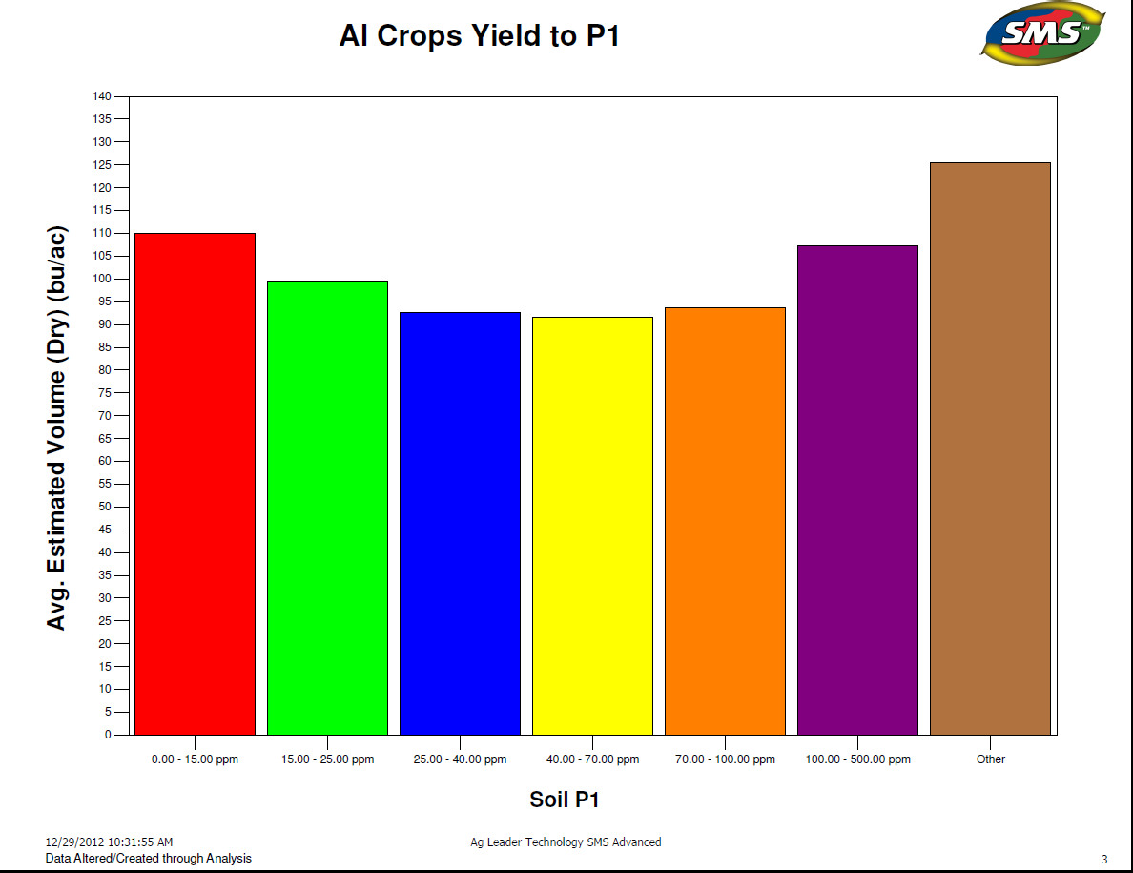
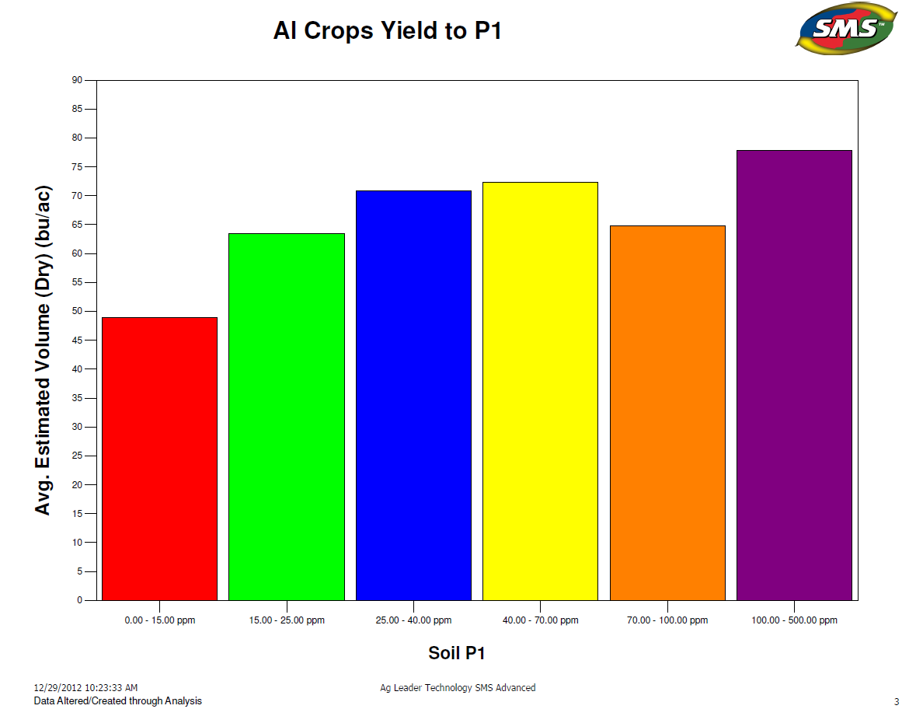
Phosphorous
2011 3400 Acres
2012 4700 Acres
2012 4700 Acres

Slide 25
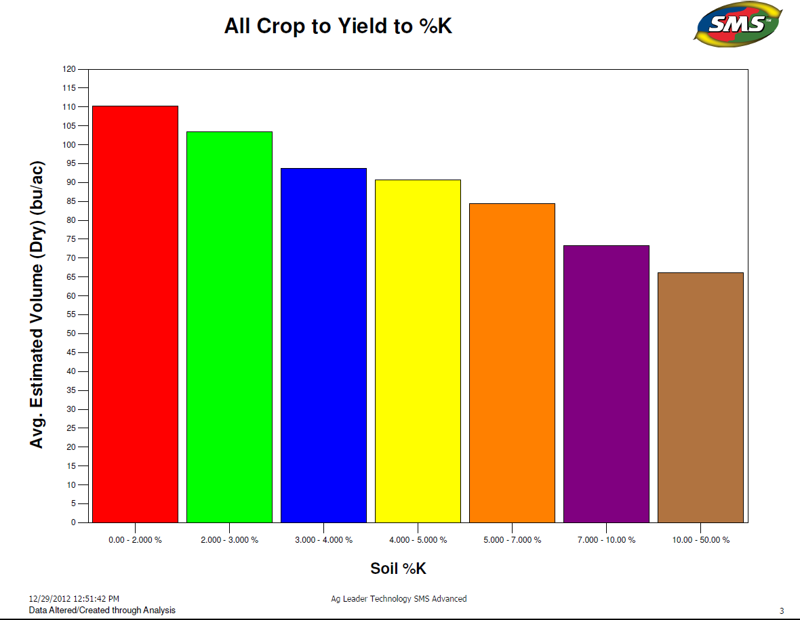
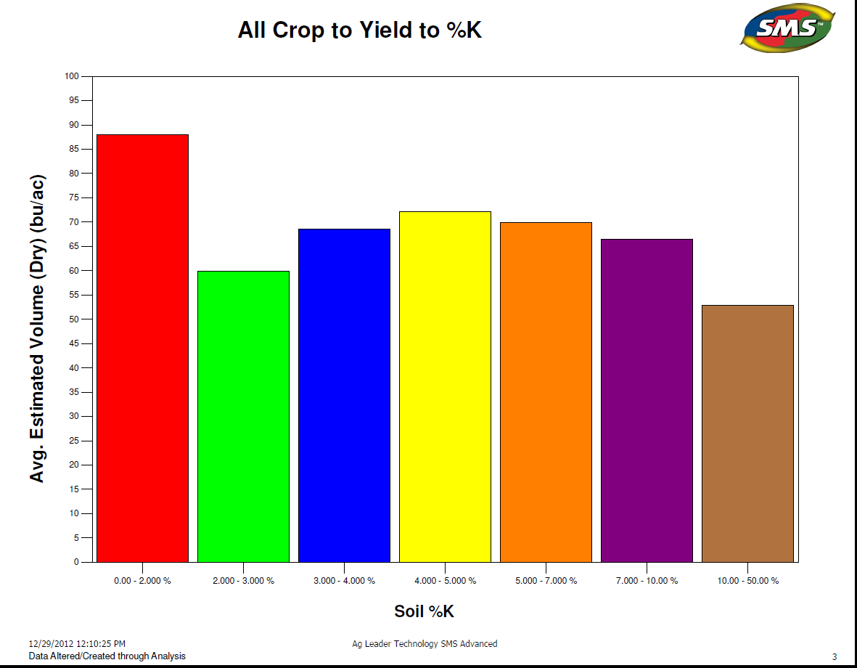
% Potassium Base
2011 3400 Acres
2012 4700 Acres

Slide 26
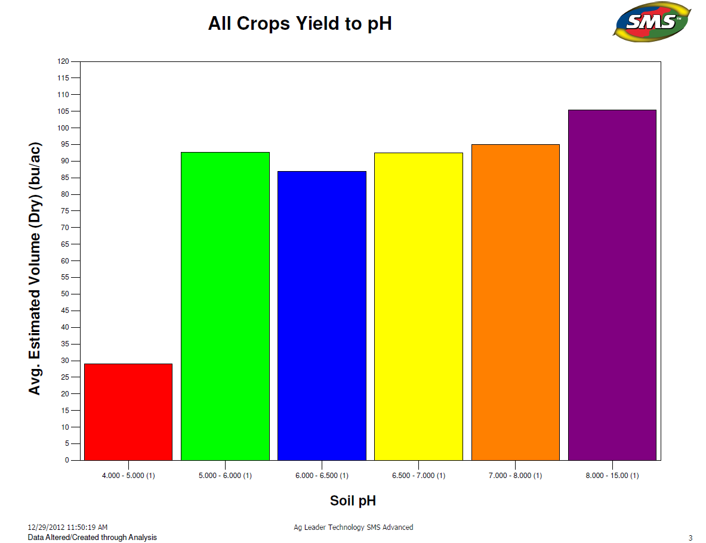
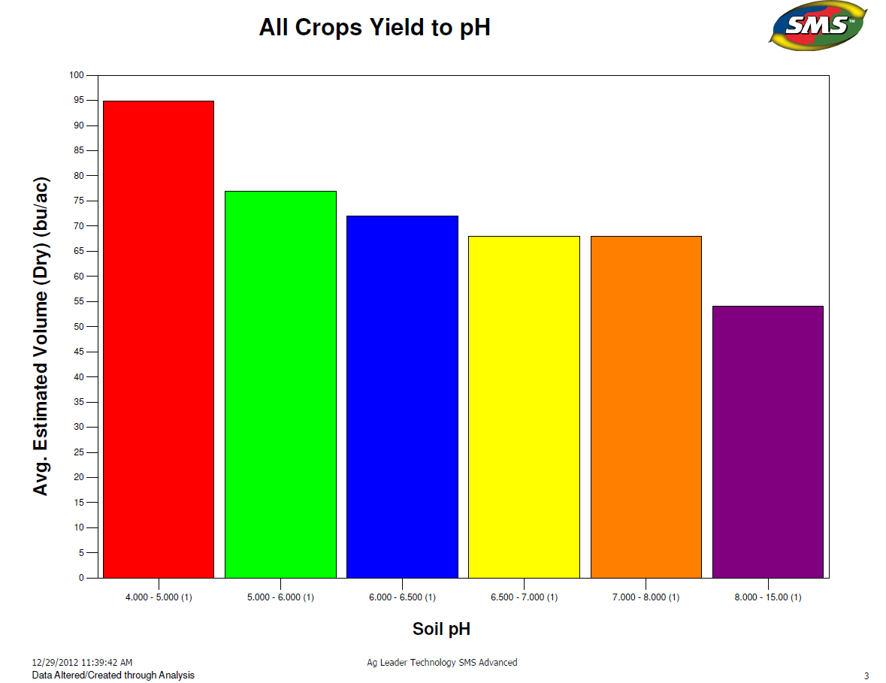
pH
2011 3400 Acres
2012 4700 Acres

Slide 27
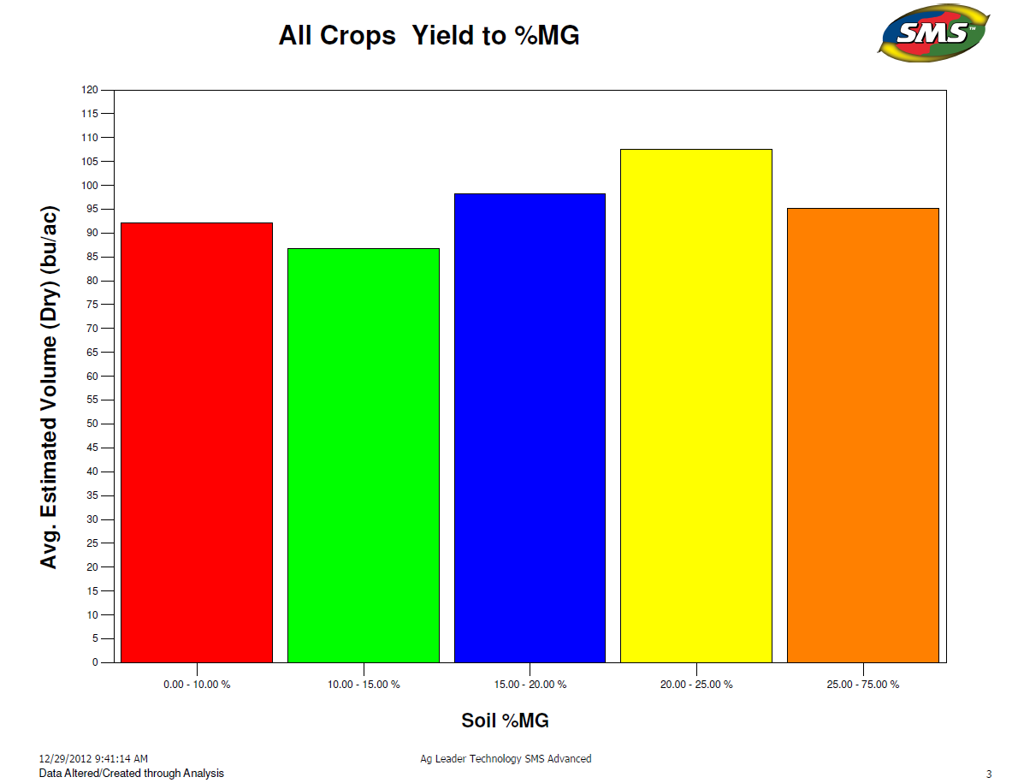
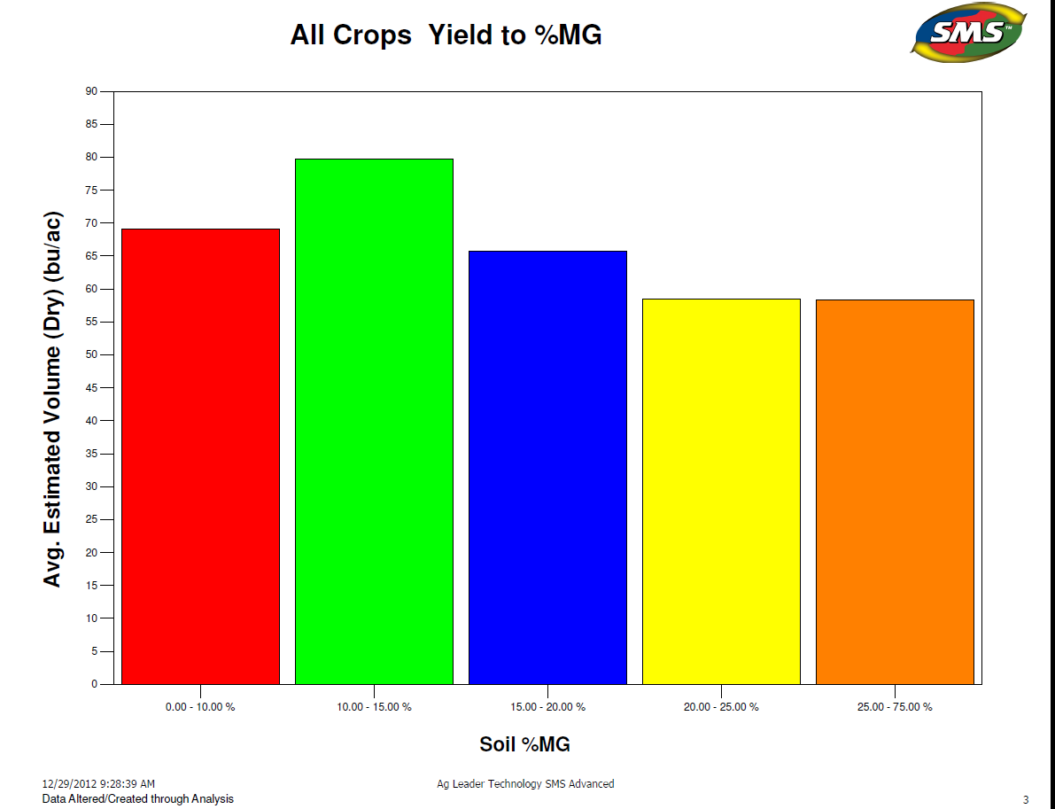
% Base Magnesium
2011 3400 Acres
2012 4700 Acres

Slide 28
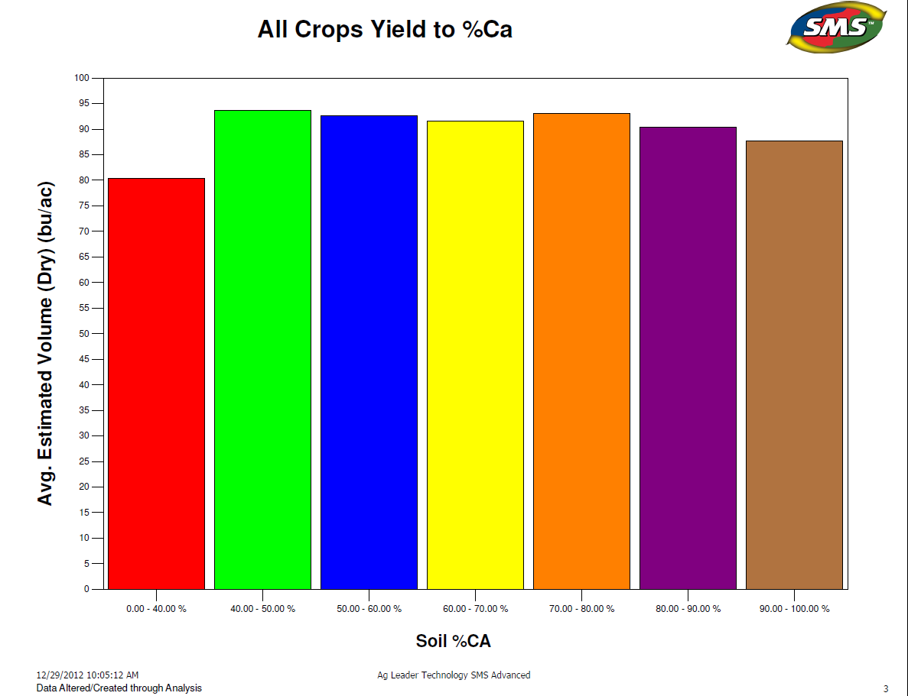
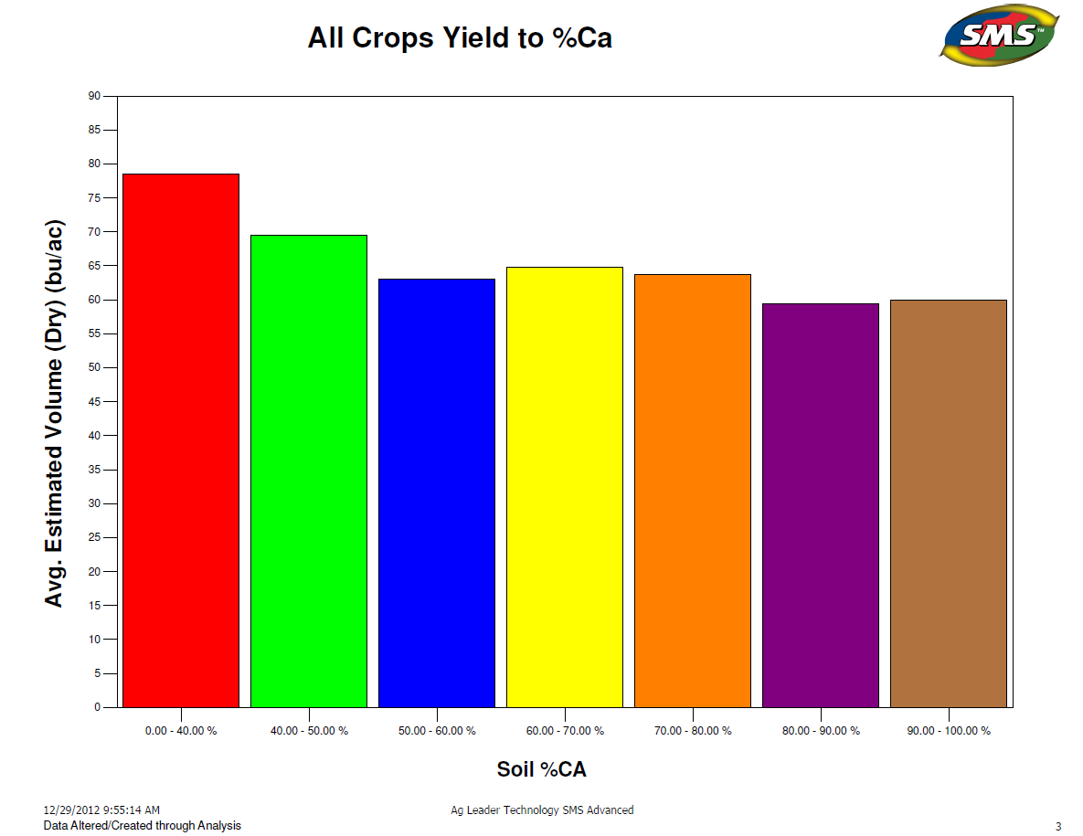
% Base Calcium
2011 4000 Acres
2012 4000 Acres

Slide 29
Summary of 2012 N Plots in a Drought Year
No Difference in Pre vs. Sidedress.
No Difference in NH3 vs. 28%.
No Difference in N Serve.
Boron worked very well in both plots.
Inconsistant performance for RX but saved N.
OptRx performed better in heavy soils.
It appears that 160 lb. rate worked best.

Slide 30
Thank You Co-operators
Alan Gould, Gould Farms
Andy Rebottaro, Rebottaro Farns
Ben Carpenter, Carpenter Farms
Blain Baker, Bakerlads Farm
Carl Brown, Kitty Kurtis
Chad Hart, Hartland Farms
Dave Squires
Dean McClenathen
Doug Wilkin, D&L Wilkin Farms
John Tuckerman
Keith and Zell Eisenimann, EGA
Larry Ries, N L Farms
Les Sieler, Hope and a Prayer Farms
Maurice Denecker
Rick Ries, Ries Family Farms
Robert Goetz
Scott Conrad
Tim Stutzman, Raymond and Stutzman
Tom Scharer, Scharer Farms
Troy VanDenbushe

Slide 31
www.useprecisionag.com

